Slide 1
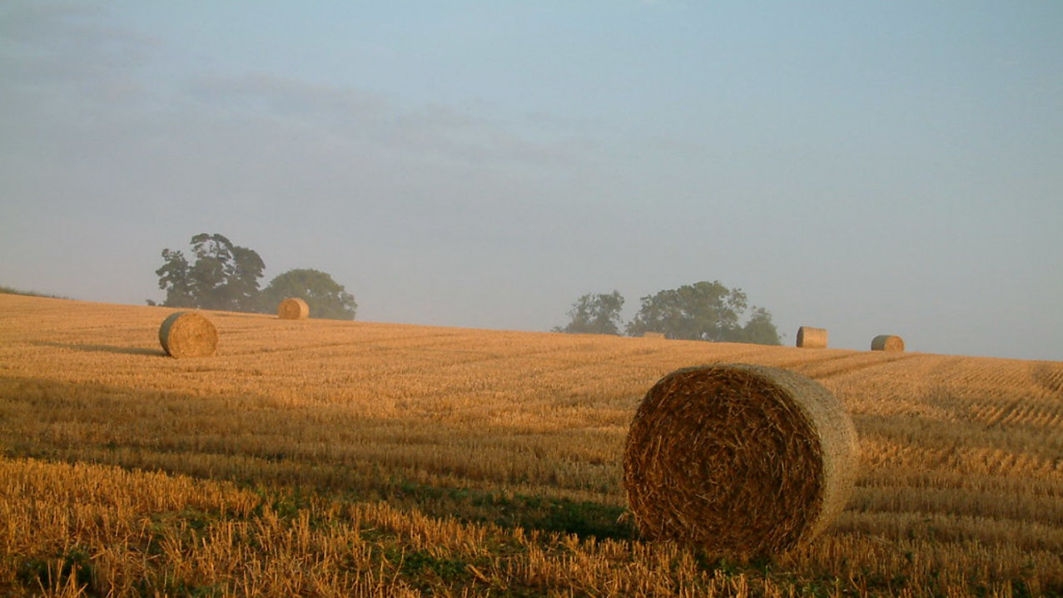




Research Priorities and Knowledge Gaps for Regenerative Agriculture – a UK analysis
Julia Cooper, Organic Research Centre
Elizabeth Stockdale, Farming Systems Research, NIAB
Belinda Clarke, Agri-TechE
organicresearchcentre.com
agri-tech-e.co.uk
niab.com
Notes:
Here are some possible themes for the breakout groups:
Impact of regenerative farming practices on soil health in regenerative farming systems
Mixed and cover cropping in regenerative farming systems
Understanding how to rebuild soil
Soil, fungi and plant interactions in regenerative farming systems
Understanding of the impact of adopting regenerative agriculture systems on farmers’ livelihoods
Understanding cultural factors that influence whether/how farmers adopt regenerative farming
Breeding and testing crops for regenerative farming
Plant populations and regenerative farming
Synthetic chemicals in regenerative farming systems
Livestock and regenerative farming systems

Slide 2
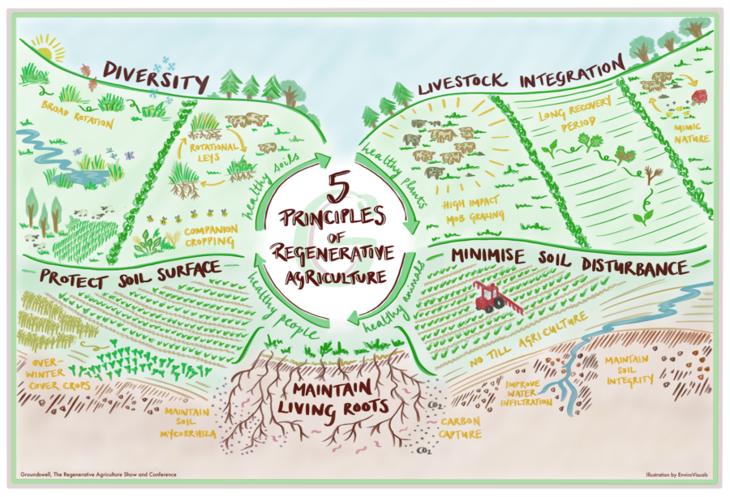
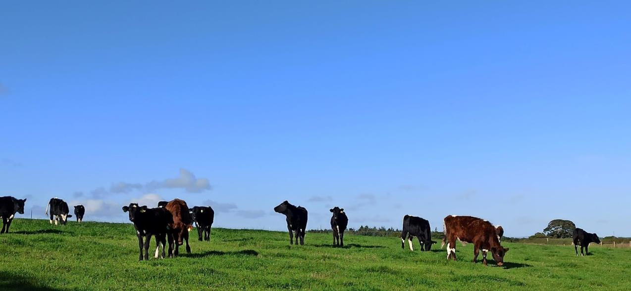
Why do more research?
Context
Don’t we already know what we need to do?
Isn’t this just good old-fashioned mixed farming?
Need to build on past research
New research techniques and innovations to support transition to regen ag

Slide 3

Identifying the gaps
Identify research priorities
Review the existing evidence
Gaps
Important research topic/challenge/barrier to regen ag
Lack of UK research or projects
=
Gaps: Top priority for research and/or knowledge exchange

Slide 4
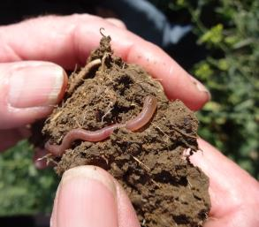
Refined list of research topics/challenges(34)
Standardizing regen ag (2)
  Definitions, metrics, certification schemes
Advice and guidance, “how to…” (11)
  Root crops, intercropping, cover crops, reducing tillage…
Crop genetics, “breeding for…” (9)
  Insect & disease tolerance, low inputs, weed competitiveness, blends, populations
Soil health (5)
  Indicators of soil biological function, mob grazing impacts, strategic (occasional) tillage
Wider system impacts (5)
  Climate change, soil carbon code, herbicides in regen ag, product quality
Socio-economics (2)
  Impacts on livelihoods, Barriers/constraints
organicresearchcentre.com
agri-tech-e.co.uk
niab.com

Slide 5
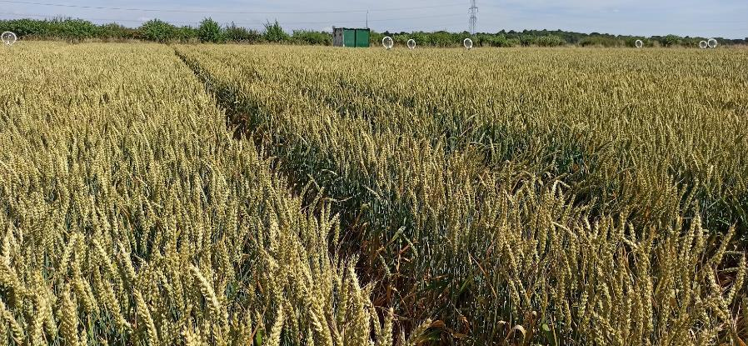
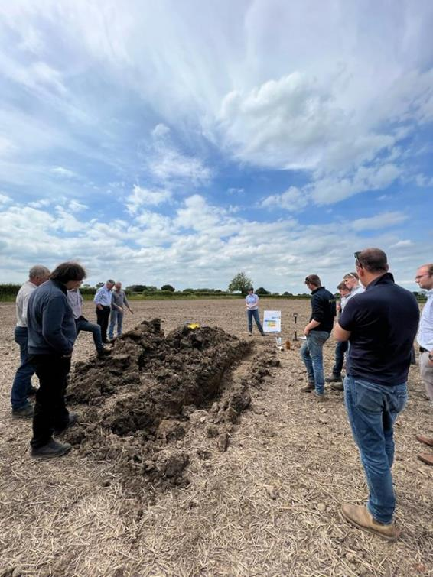

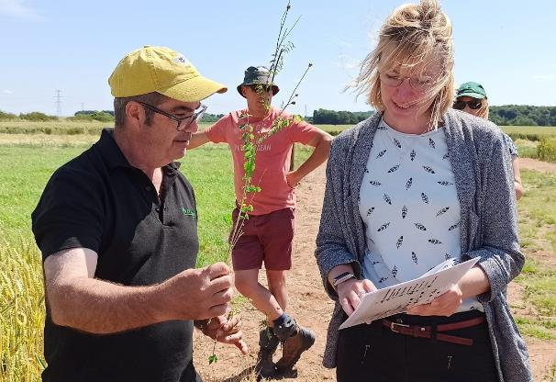

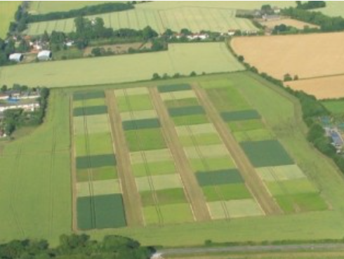

Some examples of top priority topics
Impact of regen ag systems on farm livelihoods (#1 priority at workshop)
  Moderate number of studies and projects
Applied research and knowledge exchange
Working with monitor farms, farm clusters etc.

Slide 6
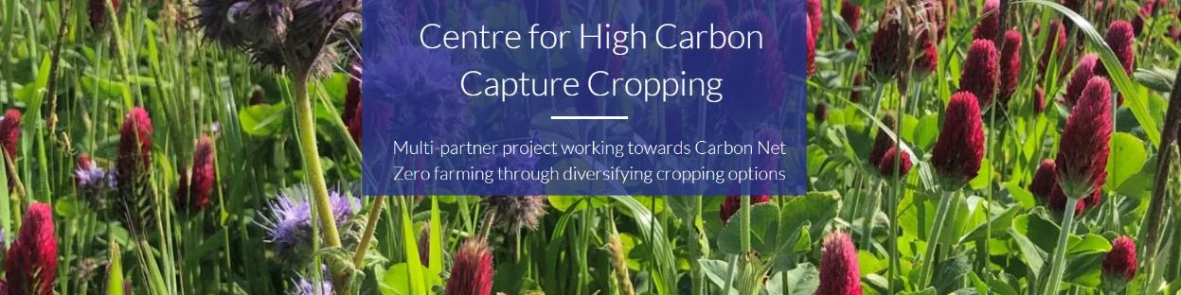


Some examples of top priority topics
Regional adaptation of cover crops, particularly for cool, wet, temperate climates
  Few peer-reviewed studies, some historical grey literature
select from the pool of existing crop varieties with a focus specifically on their role as cover crops to tackle this challenge.
collaborative efforts including facilitated knowledge sharing between farmers and seed houses are recommended
Notes:
Considering climate and soil types, evaluating and selecting cover crops (and varieties) well-suited to UK environments is a top priority for transitioning to regenerative agriculture. There is significant potential to select from within the pool of existing crop varieties with a focus specifically on their role as cover crops to tackle this challenge. Collaborative efforts including facilitated knowledge sharing between farmers and seed houses are recommended
Defra reports as long ago as 1995 on cover crops,

Slide 7


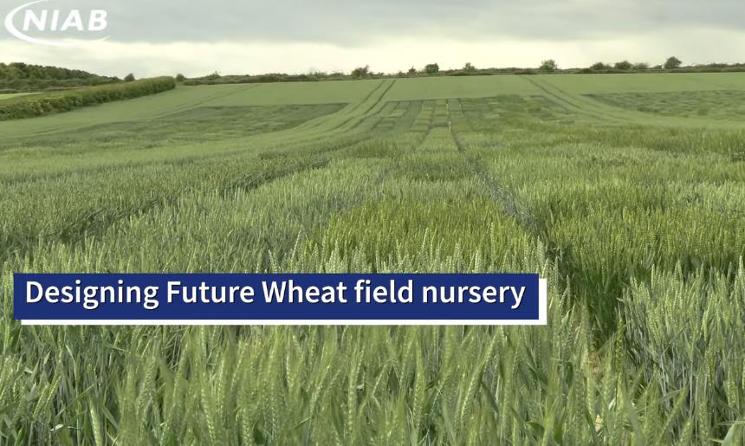
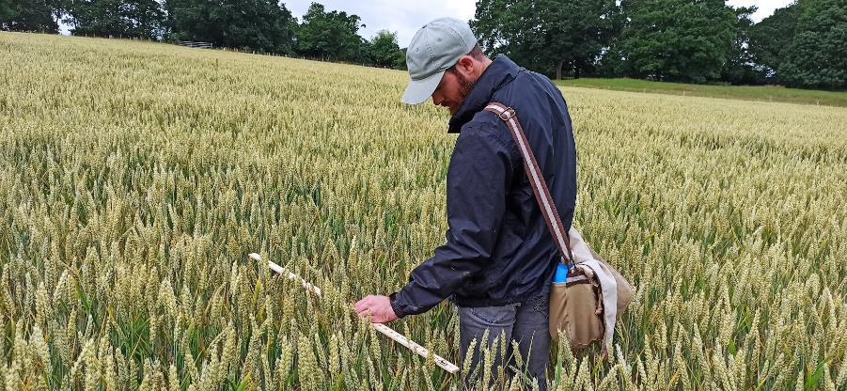
Some examples of top priority topics
Variety evaluation and breeding for low N and pesticide inputs
  Moderate number of peer-reviewed studies, several past and current projects
Exploiting novel wheat genotypes for regenerative agriculture
Link with recent AHDB RL review & scoping study
Trialling modern wheat varieties, blends and populations in organic systems
Using modern and older varieties in regen systems

Slide 8
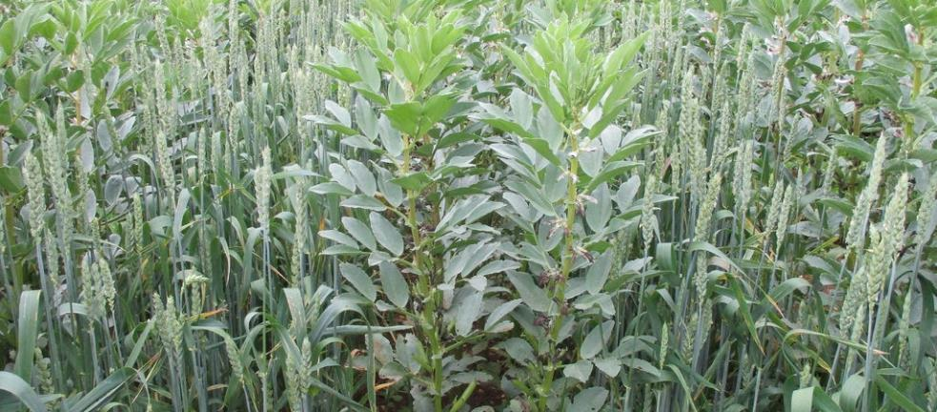
Some examples of top priority topics
Intercropping arable crops successfully
  100s of peer-reviewed papers globally and a few key projects in the UK
…key to developing more diversified cropping systems..

Slide 9
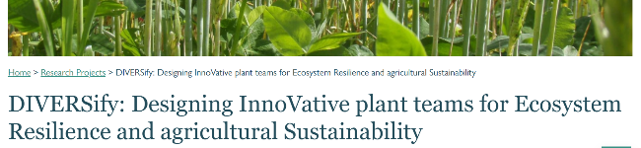
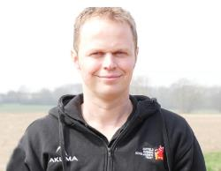
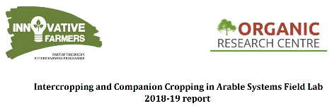

Intercropping arable crops successfully – applied research linked to KE
…field trials with farmers…practical guide...
The potential for companion cropping and intercropping on UK arable farms (Howard, 2016)
…regional demonstrations…dedicated research teams...
organicresearchcentre.com
agri-tech-e.co.uk
niab.com

Slide 10

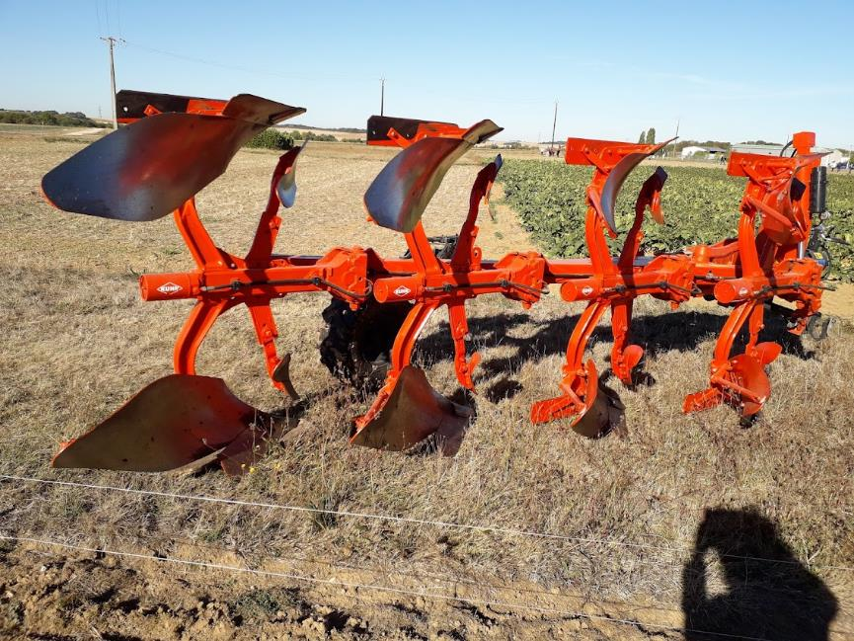
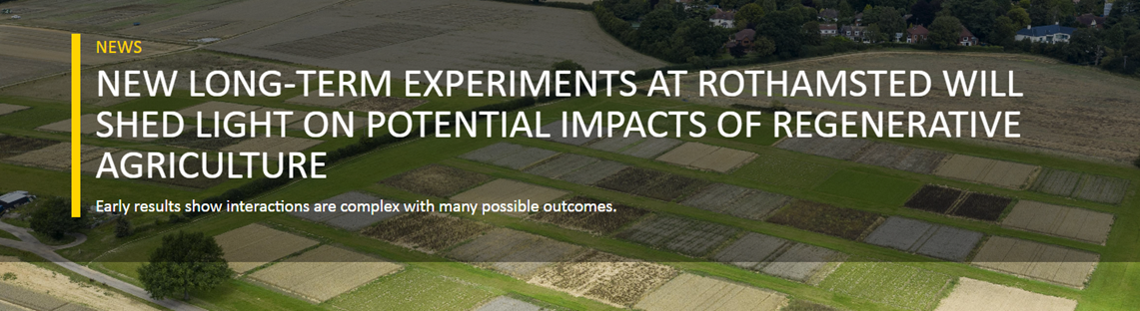

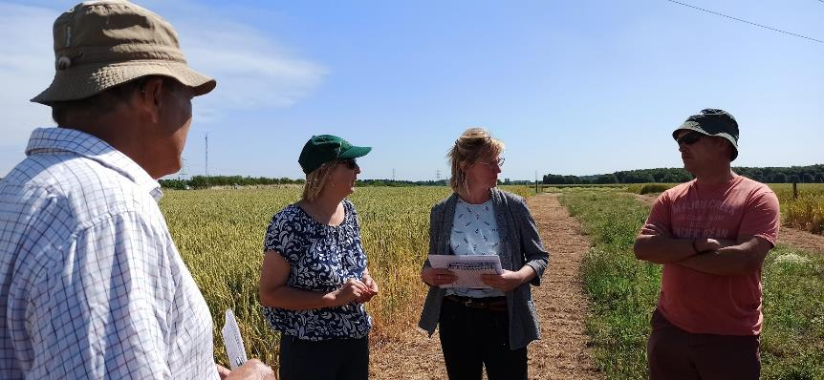
Some examples of top priority topics
Impacts of strategic tillage vs glyphosate on soil health
  ~100 peer-reviewed papers globally on occasional tillage; but virtually no studies in the UK
  ~100 peer-reviewed papers globally on glyphosate and soil health
  Various projects about tillage in general in UK that may include no-till versus tillage, but none that specifically address this question
Include direct drill vs moldboard ploughing; but no glyphosate treatment; no occasional tillage

Slide 11
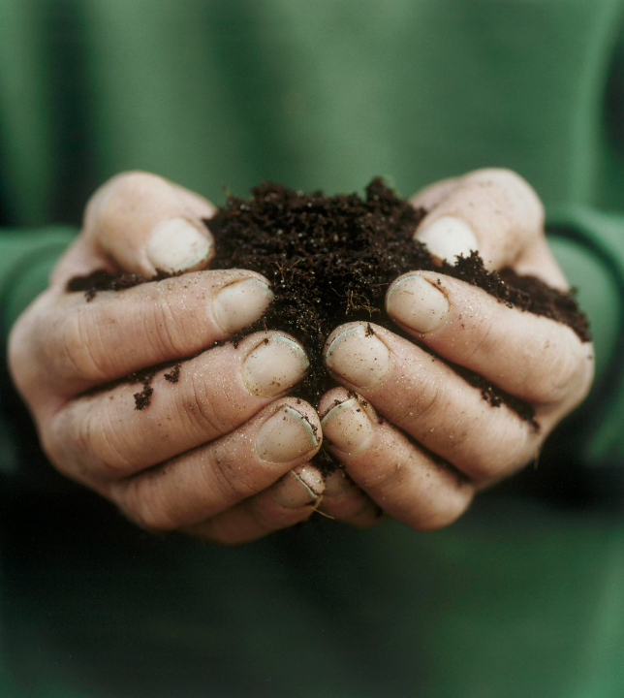
Final Thoughts
Extensive background knowledge for many of the identified challenges
Ongoing projects that will help to address many of these questions
Next steps - form working groups to develop strategies for these key areas
Build on the information we have gathered on past projects and
To really shift the dial – integrated approaches, working across these challenges in a multi-disciplinary way
organicresearchcentre.com
agri-tech-e.co.uk
niab.com

